Slide 1
Introduction to Air Pollution
Presented by
Dr. Yu-Chieh Ting

Slide 2
Scale and Complexity of Air Pollution– Introduction
Air pollution exists at all scales, from personal to global.
Ambient air pollution scales may be further subdivided into local, urban, regional, continental, and global.
The spheres of influence of the air pollutants themselves range from molecular (e.g. gases and nanoparticles) to planetary (e.g. dispersion of greenhouse gases throughout the troposphere).
The spatial extent of the local scale is a radius of up to about 5 km on the earth’s surface. The urban scale extends the radius to about 50 km. The regional scale radius is from 50 to 500 km. Continental scales are from 500 to several 1000 km in any direction, but is often the direction of the winds aloft, since this the route traversed by the pollutant. The global scale extends worldwide.

Slide 3
Scale and Complexity of Air Pollution– Mechanical Scale and Complexity
Cellular transport is discussed throughout this text. The same laws of motion apply to every scale.
Since physics and chemistry both play prominent roles in chemical transformation, the dynamics must be understood at each scale.
Indeed, some of the terms used by chemists are the same as those used by physicists, but their meanings are somewhat nuanced, e.g. kinetics, equilibrium, and dynamic.

Slide 4
Numerous air terms have different connotations within the contexts of scale and complexity.
For example, the term particle at the atomic scale usually means an atom, molecule, ion, or even an electron; whereas particle in most air pollution discussions means a single aerosol.
Models often use the particle concept to represent a part of the atmosphere, analogous to a geometric point as a theoretical component of an air mass.
Similarly, the term diffusion to most physicists and chemists means molecular movement due to concentration gradients, but for others working in air pollution, the term is nearly synonymous with the spread and dilution of substances in a plume.
Notes:
Connotation:含意; analogous:相似的; synonymous:同義的

Slide 5
The term pathway also has scale and complexity dependence, such as the pathways representing modes of action leading to an effect from a dose at the cellular scale, versus the pathways of exposure that are larger scale (e.g. air that is inhaled, water that is consumed, soil that is contacted by skin).
Ambiguity is always problematic in the life sciences, especially the biomedical and environmental sciences, and engineering.
This section is to clarify and differentiate the meanings of key terms within the context of time and space.

Slide 6
Mechanics is the field of physics concerned with the motion and the equilibrium of bodies within particular frames of reference.
Engineering mechanics is important, for example, the design of pollution control equipment must properly account for statics and dynamics.
Fluid mechanics is a particularly important branch of the mechanics of air pollution.
Statics is the branch of mechanics that is concerned with bodies at rest with relation to some frame of reference, with the forces between the bodies, and with the equilibrium of the system.
It addresses rigid bodies that are at rest or moving with constant velocity.

Slide 7
Hydrostatics is a branch of statics that is essential to environmental science and engineering in that it is concerned with the equilibrium of fluids (liquids and gases) and their stationary interactions with solid bodies, such as pressure.
While many fluids are considered by environmental assessments, the principal fluids are water and air.
Dynamics is the branch of mechanics that deals with forces that change or move bodies.
It is concerned with accelerated motion of bodies. It is an especially important science and engineering discipline because it is fundamental to understanding the movement of contaminants through the environment.
Dynamics is sometimes used synonymously with kinetics.
However, this text prefers the engineering approach to treat kinetics as one of the two branches of dynamics, with the other being kinematics.

Slide 8

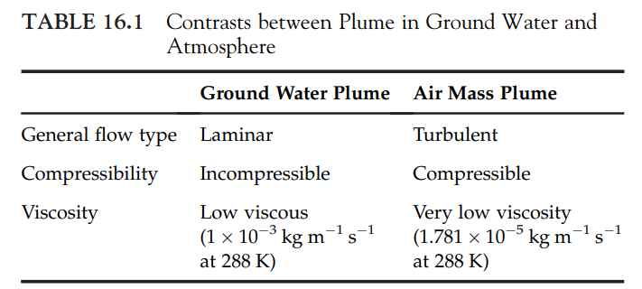
Dynamics combines the properties of the fluid and the means by which it moves.
The continuum fluid mechanics vary by whether the fluid is viscous or inviscid, compressible or incompressible, and whether flow is laminar or turbulent.
For example, the properties of the two principal environmental fluids, i.e. water in an aquifer and an air mass in the troposphere, are shown in Table 16.1. Thus, in air pollution mechanics, turbulent systems are quite common. However, within smaller systems, such as control technologies, laminar conditions can be prominent.

Slide 9
Kinematics is concerned with the study of a body in motion independent of forces acting on the body. That is, kinematics is the branch of mechanics concerned with motion of bodies with reference to force or mass.
This is accomplished by studying the geometry of motion irrespective of what is causing the motion.
Kinematics relates position, velocity, acceleration, and time. Kinematic principles will be applied extensively in the following chapters.
Aerodynamics and hydrodynamics are the important branches of environmental mechanics. Both are concerned with deformable bodies and with the motion of fluids.
They provide an important underlying aspect of contaminant transport and movements of fluids, and consider fluid properties such as compressibility and viscosity.

Slide 10
These are crucial properties in explaining the movement of contaminants within plumes, flows in vents and pipes, and design of air pollution control systems.
Kinetics is the study of motion and the forces that cause motion.
This includes analyzing force and mass as they relate to translational motion.
Kinetics also considers the relationship between torque and moment of inertia for rotational motion.
Chemists often refer to kinetics as those reactions that have yet to reach equilibrium, i.e. equality between both sides of the reaction.
Kinetic reactions employ a one-direction arrow ( ), whereas equilibria show a two-direction arrow ( ).
Notes:
Inertia:慣性

Slide 11
A key concept for environmental dynamics within the context of physical motion is that of linear momentum, the product of mass and velocity.
A body’s momentum is conserved unless an external force acts upon a body.
Kinetics is based on Newton’s first law of motion, which states that a body will remain in a state of rest or will continue to move with constant velocity unless an unbalanced external force acts on it.
Stated as the law of conservation of momentum, linear momentum is unchanged if no unbalanced forces act on a body.
If the resultant external force acting on a body is zero, the linear momentum of the body is constant.

Slide 12

Kinetics is also based upon Newton’s second law of motion, which states that the acceleration of a body is directly proportional to the force acting upon that body, and inversely proportional to the body’s mass.
The direction of acceleration is the same as the force of direction. The equation for the second law is:
Newton’s third law of motion states that for every acting force between two bodies, there is an equal but opposite reacting force on the same line of action:

Slide 13
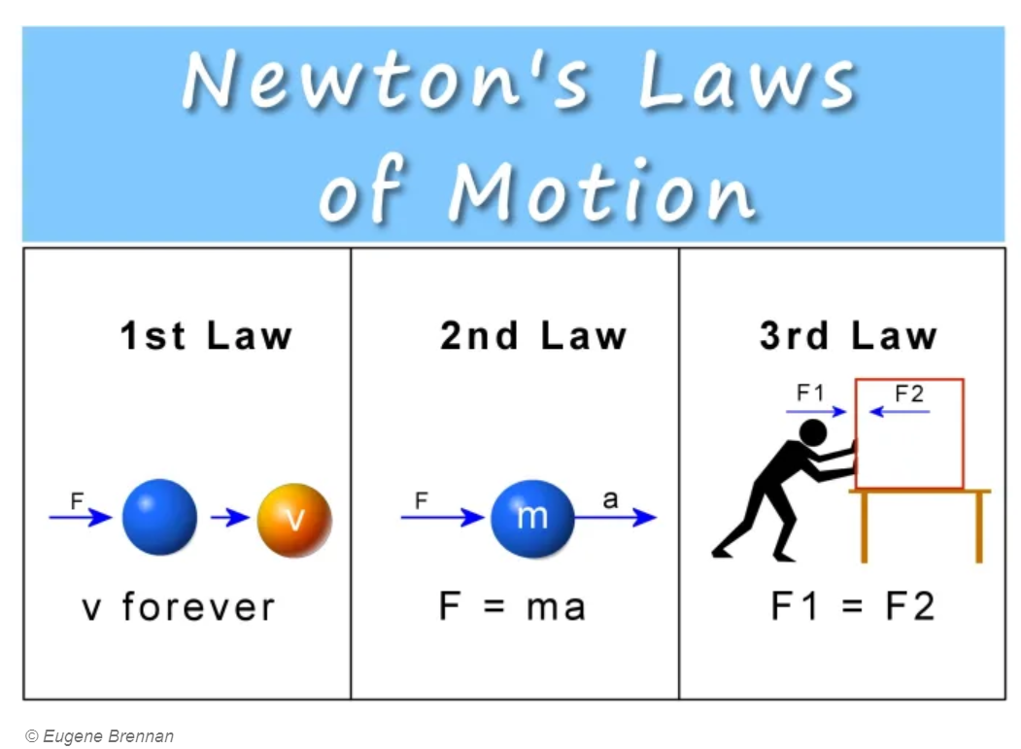

Slide 14
Another force that is important in air pollution is friction, which is a force that always resists motion or an impending motion.
Friction acts parallel to the contacting surfaces.
Friction acts parallel to the contacting surfaces. When bodies come into contact with one another, friction acts in the direction opposite to that which is bringing the objects into contact.
Forces are an important part of air pollution control systems, which will be discussed in the following chapters.

Slide 15
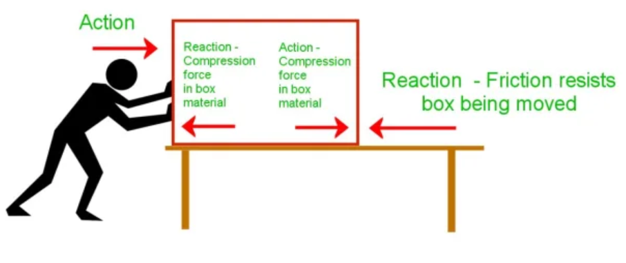
Notes:
FRICTION FIGURE

Slide 16
Air pollutants may move within one environmental compartment, such as a source within a home.
Most often, however, pollutants move among numerous compartments, such as when a contaminant moves from the source to the atmosphere, until it is deposited to the soil and surface waters, where it is taken up by plants, and eaten by animals.
Science is by necessity compartmentalized among physics, chemistry, and biology.
Complex topics like pollutant transport require that all three of the sciences be considered.
The general behavior of contaminants after they are released is shown in Figure 16.1.

Slide 17
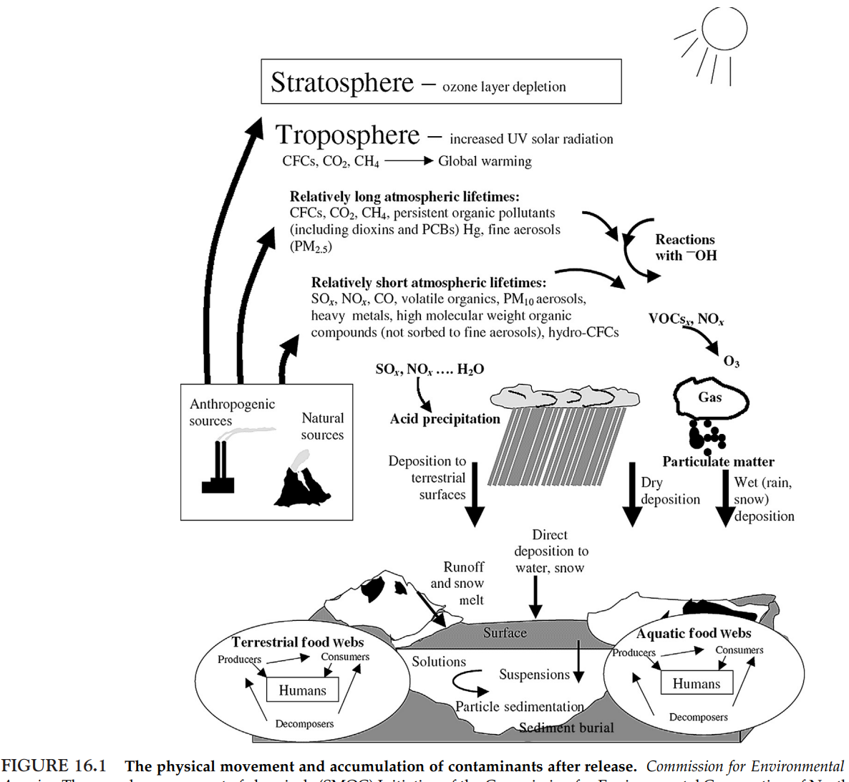

Slide 18
The movement of pollutants is known as transport.
This is half of the often cited duo of environmental “fate and transport”.
Fate is an expression of what contaminant becomes after all the physical, chemical, and biological processes of the environment have acted.
The pollutant will undergo numerous changes in location and form before reaching its fate.
Throughout the contaminant’s journey, it will be physically transported and undergo coincidental chemical processes, known as transformations, such as photochemical and biochemical reactions.
Certainly, fate implies more than physical transport. The fate of an air pollutant depends on abiotic chemical reactions, such as photolysis, endothermic, and exothermic reactions, and mechanical separation processes, as well as biotic transformation, e.g. microbial degradation.

Slide 19
Usually, in the discussions of fate and transport, the reactions are those that occur in the ambient environment.
The intentional treatment and control processes usually fall under the category of environmental engineering.
If a chlorinated solvent is released from a factory’s vents and stacks, it may undergo transformations in the atmosphere before it reaches the soil.
In the soil, the microbially mediated transformations may change the chemical structure to a simpler molecule, e.g. by mineralization.
This lighter molecule may have a sufficiently high vapor pressure, which allows it to again move into the atmosphere, where it undergoes additional photochemical transformation, increasing its aqueous solubility.

Slide 20
This new compound is deposited onto the surface of the lake, where it is taken up by algae.
The algae are food for fish, so this transformation product is bioaccumulated and further transformed in the fish.
If the fish is eaten by humans, the ultimate fate of the original air pollutant released from the stacks and vents is in human tissue.
Thus, the fate is a consequence of physics, chemistry, and biology

Slide 21
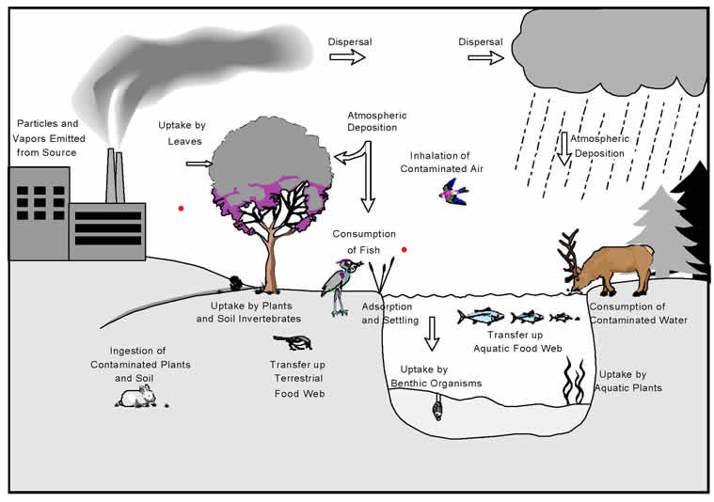
(US EPA)

Slide 22
Environmental engineering has a slightly different perspective of fate.
Engineers employ remediation reactions, such as thermal and mechanical separation processes, as well as abiotic chemical reactions, such as precipitation and hydrolysis, as well as biological processes, such as microbial metabolic biochemical reactions, to break down toxic substances into simpler, less toxic compounds.
The same processes and reactions that occur in the ambient environment mentioned in the previous paragraph are used by engineers for the treatment and control processes that usually fall under the category of environmental engineering.
Engineers have simply changed the scale from large environmental compartments like air masses and lakes to smaller reactors, such as pollutant collection and treatment devices

Slide 23
Recall that a fluid is a collective term that includes all liquids and gases.
A liquid is matter that is composed of molecules that move freely among themselves without separating from each other.
A gas is matter composed of molecules that move freely and are infinitely able to occupy the space with which they are contained at a constant temperature.
A fluid is a substance that will deform continuously upon the application of a shear stress; i.e. a stress in which the material on one side of a surface pushes on the material on the other side of the surface with a force parallel to the surface.

Slide 24
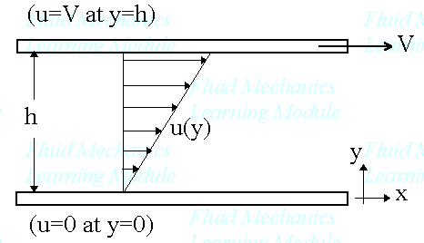
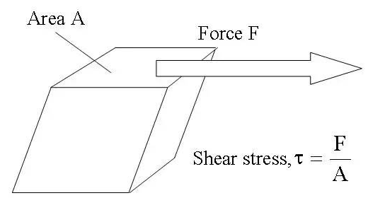
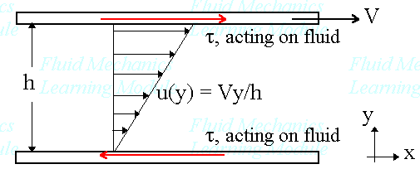


Slide 25
Fluids are generally divided into two types: ideal and real.
The ideal has zero viscosity and, thus, no resistance to shear (explained below).
An ideal fluid is incompressible and flows with uniform velocity distributions.
It also has no friction between moving layers and no turbulence (i.e. eddy currents).
On the contrary, a real fluid has finite viscosity, has nonuniform velocity distributions, is compressible, and experiences friction and turbulence.
Real fluids are further subdivided according to their viscosities.
A Newtonian fluid is one that has a constant viscosity at all shear rates at a constant temperature and pressure. Water and most solvents are Newtonian fluids.
However, environmental engineers are confronted with non-Newtonian fluids, i.e. those with viscosities not constant at all shear rates. Sites contaminated with drilling fluids and oils have large quantities of non-Newtonian fluids onsite.

Slide 26
One of the concepts of the particle is a theoretical point that has mass and location, but no geometric extension.
Particle can be observed as it moves within the fluid as a representation of where that portion of the fluid is going and at what velocity.
Another spatial and thermodynamic concept is the control volume, which is an arbitrary region in space that is defined by boundaries.
The control volume’s boundaries may be either stationary or moving.
The control volume is a means of applying the first law of thermodynamics, i.e. conservation of mass and energy.
The amount of mass or energy entering a control volume must equal the amount exiting the control volume plus what remains in the control volume.
The control volume is useful in measuring and modelling the amount of an air pollutant entering, remaining, and exiting a parcel of air, water, soil, or even a cell or parcel of tissue in an organism

Slide 27


Contaminant transport requires motion. This highlights the need of understanding the spatial context and complexity of not only the air pollutant, but of the fluid behavior.
The forces acting on a fluid may be body forces or surface forces.
The former are forces that act on every particle within the fluid, occurring without actually making physical contact, such as gravitational force. The latter are forces that are applied directly to the fluid’s surface by physical contact.
Stress represents the total force per unit area acting on a fluid at any point within the fluid volume. So, stress at any point P is
Where,

Slide 28
Fluid properties are characteristics of the fluid that are used to predict how the fluid will react when subjected to applied forces.
If a fluid is considered to be infinitely divisible, that is, it is made up of many molecules that are constantly in motion and colliding with one another, this fluid is in continuum.
Assuming that a fluid is a continuum allows for the fluid’s properties to be functions of position and time.
Fluid properties are important at every scale of air pollution.

Slide 29

Fluid properties must be considered at the cellular scale, e.g. flow through cell membranes.
Such fluid properties can be represented by two fields. The density field is represented by:
Where
The other fluid field is the velocity field:

Slide 30



When a rate of change equals zero, the system is said to be in steady state.
If the fluid properties and the flow characteristics at each position do not vary with time, the fluid is at steady flow:
And
Conversely, a time-dependent flow is considered to be an unsteady flow.
Any flow with unchanging magnitude and direction of the velocity vector is considered to be a uniform flow.

Slide 31
Fluids, then, can be classified according to observable physical characteristics of flow fields.
Laminar flow is in layers, whereas turbulent flow has random movements of fluid particles in all directions.
In incompressible flow, the variations in density are assumed to be constant, while the compressible flow has density variations, which must be included in flow calculations.
Viscous flows must account for viscosity while inviscid flows assume viscosity is zero.
The velocity field is very important in environmental modelling, especially in modelling plumes in the atmosphere and in groundwater, since the velocity field is a way to characterize the motion of fluid particles and provides the means for computing these motions.
The velocity field may be described mathematically using Eq. (16.5). This is known as the Eulerian viewpoint.

Slide 32
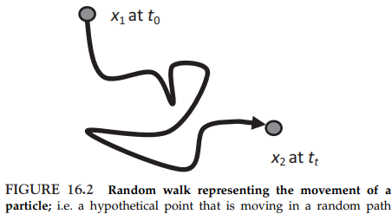
Another way to characterize the fluid movement (i.e. flow) is to follow the particle (sometimes referred to as a “parcel”) as it moves, using time functions that correspond to each particle as shown in Figure 16.2.
Molecular diffusion is important at very small distances and for very small particles (0.1 mm diameter) given that Brownian motion allows them to move in a “random walk” away from the air stream.
Interception works mainly for particles with diameters between 0.1 and 1 mm.

Slide 33
The particle does not leave the air stream but comes into contact with the filter medium (e.g. a strand of fiberglass).
Inertial impaction collects particles that are sufficiently large to leave the air stream by inertia (diameters 1 mm). This random walk of the particle provides what is known as the Lagrangian viewpoint, which is expressed mathematically as:
A Lagrangian plume model characterizes the plume by calculating the air dispersion from statistics of the trajectories of a large number of the particles (enough to represent the whole plume).

Slide 34
The major means by which air pollutants move in the atmosphere is advection, i.e. they move with the flow of the fluid where they reside, i.e. the air.
This change in position in space is the fluid velocity (V); This is a vector field quantity.
Speed (V) is the magnitude of the vector velocity V at some given point in the fluid, and average speed (V) is the mean fluid speed through a control volume’s surface.
Therefore, velocity is a vector quantity (magnitude and direction), while speed is a scalar quantity (magnitude only). The standard units of velocity and speed are meter per second (m s⁻¹ )

Slide 35
Velocity informs mixing rates after a pollutant is emitted into a plume.
If an air pollutant is released into a well-mixed chamber, calculations of concentration would be simpler than an unmixed chamber.
This is an example of the difficulty in stepping up laboratory or mesoscale findings to the real world.
For example, an air pollutant plume is never homogeneous. It is certainly likely to have higher concentrations near the source, but it will also have pockets of higher and lower concentrations given the variability of terrain, structures, albedo, clouds, temperature, and moisture.
Even a small compartment, e.g. a room in a house, is never completely mixed, with regions of varying pollutant concentrations.

Slide 36

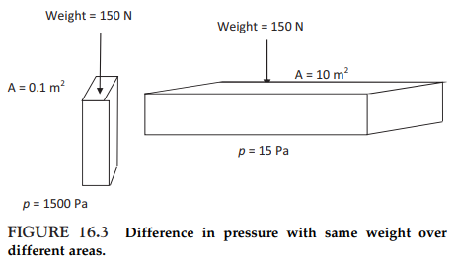
Pressure (p) is also important at all scales. Recall that p is a force per unit area:
p is a type of stress that is exerted uniformly in all directions.
The standard unit of p is the Pascal (Pa), which is equal to 1Nm⁻² .
Pressure varies with area, as shown in Figure 16.3. In this example, the same weight (force) over different areas leads to different pressures, much higher pressure when the same force is distributed over a smaller area

Slide 37
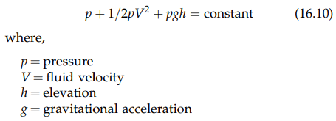
When considering p for a gas, the pressure is an average of the forces against the vessel walls; i.e., gas pressure.
Fluid pressure is a measure of energy per unit volume per the Bernoulli equation, which states that the static pressure in the flow plus one half of the density times the velocity squared is equal to a constant throughout the flow, referred to as the total pressure of the flow:
To adhere to the conservation of energy principle, a flowing fluid will maintain the energy, but velocity and pressure can change.

Slide 38
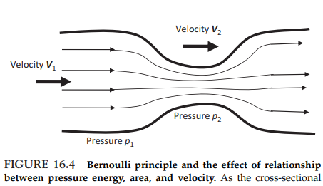
In fact, velocity and pressure will compensate for each other to adhere to the conservation principle, as stated in the Bernoulli equation:
This is shown graphically in Figure 16.4. The so-called “Bernoulli effect” occurs when increased fluid speed leads to decreased internal pressure.
In many air pollution scenarios, fluid pressure is measured against two references: zero pressure and atmospheric pressure.

Slide 39
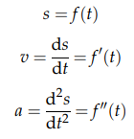
In the complexities of any air mass or other fluid bodies in the environment, the fluid concepts must be combined to describe fluid movement.
If given the function f(t) as the displacement of a particle in the fluid at time t, the derivative of this function f’(t) represents the velocity. The second derivative f’’(t) represents the acceleration of the particle at time t:

Slide 40

Specific volume The reciprocal of a substance’s density is known as its specific volume (v). This is the volume occupied by a unit mass of a fluid. The units of y are reciprocal density units (m³ kg⁻¹ ).
Specific weight As discussed in Chapter 1, the weight of a fluid per its volume is known as specific weight ( ). A substance’s g is not an absolute fluid property because it depends on the fluid itself and the local gravitational force:
The units are the same as those for density; e.g. kg m⁻³ .
Mole Fraction In a composition of a fluid made up of two or more substances (A, B, C, .), the mole fraction (x_{A}, x_{B}, x_{C}, .) is the number of moles of each substance divided by the total number of moles for the whole fluid:
Notes:
Reciprocal:倒數

Slide 41
The mole fraction value is always between 0 and 1. The mole fraction may be converted to mole percent as:
For gases, the mole fraction is the same as the volumetric fraction of each gas in a mixture of more than one gas.
Compressibility The fractional change in a fluid’s volume per unit change in pressure at constant temperature is the fluid’s coefficient of compressibility.
Gases, like air are quite compressible. That is, gases have large variations in density, much larger than in liquids.
However, any fluid can be compressed in response to the application of pressure (p). For example, water’s compressibility at 1 atm is 4.9*10⁻⁵ atm⁻¹ . This compares to the lesser compressibility of mercury (3.9*10⁻⁶ atm⁻¹ ) and the much greater compressibility of hydrogen (1.6*10⁻³ atm⁻¹ ).

Slide 42
Scale and Complexity of Air Pollution– Air Pollution Variability and Uncertainty
In air pollution, variability exists at every scale regarding the amount and type of pollutant released, the transport, transformation and fate of the pollutant, the potential exposures to the pollutant, and possible outcomes resulting from contact with the pollutant for numerous receptors and their specific characteristics (e.g. demographic and socioeconomic status for human populations; biological organization and trophic status for ecosystems) or activities (e.g. the amount of water or fish consumed on a daily basis, residence in geographic areas).

Slide 43
Variability affects the precision of estimates of air pollution quantities and location, as well as the degree to which results may be generalized.
Examples of the kinds of air pollution variability include human (intra- and interindividual), ecosystem (predatoreprey, productivity and diversity), which includes both spatial and temporal variabilities.
Human variability describes person-to-person differences in biological susceptibility, exposure, and effects from contact with air pollutants.
Species and subspecies (e.g. polymorphisms) of organisms vary in their response to pollutants.
This makes for difficulties in extrapolating results from animal studies to humans (both cancer and noncancer), as well as extrapolating the condition of an ecosystem from the condition of just a few species in that system.
Variability may be both intraspecies and interspecies.

Slide 44
Intra-individual variability refers to the changes that occur in one person over time. These changes can be physiological (e.g. body weight, age, and cognitive function) or behavioral (e.g. ingestion rates and activity patterns).
Inter-individual variability refers to the differences among individuals within a population.

Slide 45
Scale and Complexity of Air Pollution– Air Pollution Scales in Space and Time
Air pollution varies spatially and temporally, i.e. in space and time, respectively.
Spatial variability can occur at regional, local, neighborhood, microenvironmental, and personal scales.
Temporal variability occurs over large time horizons, from very long or to very short periods, such as seasonality or even daily.

Slide 46
Local
Local air pollution problems are usually characterized by one or several large emitters or a large number of relatively small emitters.
A local example of a concentration gradient shows that any ground-level source, such as evaporation of volatile organic compounds from a waste treatment pond, will produce the highest concentrations near the source, with concentrations generally diminishing with distance.
Large sources that emit high above the ground through stacks, such as those in power plants or industrial sources, can also cause local problems, especially under unstable meteorological conditions that cause portions of the plume to reach the ground in high concentrations.

Slide 47
Usually, the most acute effects of accidental releases are at the local scale.
For example, a fire, derailed rail car leak, or an industrial accident usually requires evacuation from within a local area.
Urban
Air pollution problems in urban areas generally are of two types.
One is the release of primary pollutants (those released directly from sources). The other is the formation of secondary pollutants (those that are formed through chemical reactions of the primary pollutants).
Air pollution problems can be caused by individual sources on the urban scale as well as the local scale.
For pollutants that are relatively nonreactive, such as carbon monoxide and particulate matter, or relatively slowly reactive, such as sulfur dioxide, the contributions from individual sources combine to yield high concentrations.

Slide 48
Since a major source of carbon monoxide is motor vehicles, “hot spots” of high concentration can occur especially near multilane intersections.
The emissions are especially high from idling vehicles.
The hot spots are exacerbated if high buildings surround the intersection, since the volume of air in which the pollution is contained is severely restricted.
Tropospheric ozone is the dominant urban problem resulting from the formation of secondary pollutants.
Many large metropolitan areas experience the formation of ozone from photochemical reactions of oxides of nitrogen and various species of hydrocarbons.
These reactions are catalyzed by the ultraviolet light in sunlight and are therefore called photochemical reactions

Slide 49
Many metropolitan areas are in nonattainment for ozone; that is, they are not meeting the air quality standards.
The Clean Air Act Amendments (CAAA) of 1990 recognized this as a major problem and have classified the various metropolitan areas to be in nonattainment according to the severity of the problem for that area.
Oxides of nitrogen, principally nitric oxide (NO) but also nitrogen dioxide (NO₂), are emitted from automobiles and from combustion processes.
Hydrocarbons are emitted from many different sources.
The various species have widely varying reactivities.

Slide 50
Regional
At least three types of problems contribute to air pollution problems on the regional scale.
The first is the blend of urban oxidant problems at the regional scale.
Many major metropolitan are in close proximity to one another and continue to grow.
As a result, the air from one metropolitan area, containing both secondary pollutants formed through reactions and primary pollutants, flows on to the adjacent metropolitan area.
The pollutants from the second area are then added on top of the “background” from the first.

Slide 51


A second type of problem is the release of relatively slow-reacting primary air pollutants that undergo reactions and transformations during lengthy transport times.
The gas, sulfur dioxide (SO₂), released primarily through combustion of fossil fuels (especially from coal and oil) is oxidized during long-distance transport to sulfur trioxide (SO₃):
Although SO₂ is a gas, both gas phase and liquid phase oxidation of SO₂ occurs in the troposphere.
The SO₃ in turn reacts with water vapor to form sulfuric acid:
Sulfuric acid in turn reacts with numerous compounds to form sulfates. These are fine (submicrometer) particulates.

Slide 52
Nitric oxide (NO) results from high-temperature combustion, both in stationary sources such as power plants or industrial plants in the production of process heat and in internal combustion engines in vehicles.
The NO is oxidized in the atmosphere, usually rather slowly, or more rapidly if there is ozone present, to nitrogen dioxide (NO₂).
NO₂ also reacts further with other constituents, forming nitrates, which is also in fine particulate form.
The sulfates and nitrates existing in the atmosphere as fine particulates, generally in the size range less than 1 µm, can be removed from the atmosphere by several processes.

Slide 53
“Rain out” occurs when the particles serve as condensation nuclei that lead to the formation of clouds.
The particles are then precipitated if the droplets grow to sufficient size to fall as raindrops.
Another mechanism, known as “washout”, also involves rain, but the particles in air are captured by raindrops falling through the air.
Both mechanisms contribute to “acid rain”, which results in the sulfate and nitrate particles reaching lakes and streams, and increasing their acidity.
As such, acid rain is both a regional and continental problem.
A third type of regional problem is visibility, which may be reduced by specific plumes or by the regional levels of particulate matter that produce various intensities of haze.

Slide 54
The fine sulfate and nitrate particulates just discussed are largely responsible for reduction of visibility.
Regional haze is a type of visibility impairment that is caused by the emissions of air pollutants from numerous sources across a broad region.
Continental
Perhaps of greatest concern on the continental scale is that the air pollution policies of a nation are likely to create impacts on neighboring nations.
Acid rain in Scandinavia has been considered to have had impacts from Great Britain and Western Europe. Japan has considered that part of their air pollution problem, especially in the western part of the country, has origins in China and Korea.
Actually, precipitation in North America was acidic even before industrialization. This is primarily due to the natural acidity rendered to water by carbon dioxide (CO₂). The CO₂ gas is dissolved into water droplets in the atmosphere, resulting in carbonic acid (H₂CO₃), which is ionized.

Slide 55
Global
The release of radioactivity from the accidents at Chernobyl and more recently in Japan would be considered primarily a regional or continental problem. However, higher than usual levels of radioactivity were detected in Western North America soon after both accidents.
Persistent organic pollutants, such as polychlorinated biphenyls, have been observed in Arctic mammals, thousands of miles from their sources.
A particularly noteworthy air pollution problem of a global nature is the release of chlorofluorocarbons used as propellants in spray cans and in air conditioners, and their effect on the ozone layer high in the atmosphere.
Notes:
Propellant:推進燃料

Slide 56
Another global problem is climate change that is generated by excessive amounts of radiant gases (commonly known as greenhouse gases), especially methane (CH₄) and CO₂.
The combine contributions from anthropogenic and natural sources of pollutants complicate the optimal range, since even the natural sources are highly variable.

Slide 57
光化學反應
光的特性
工業及交通所排出的污染物質進入大氣後，在常溫、常壓有陽光的氧化環境中，發生一系列的化學變化，而形成新的污染物質，亦即所謂的二次污染物。其化學反應可分為一般反應與光化學反應，其中以光化學反應最為複雜及重要。
光具有波動性與微粒性，亦即具有電磁波的性質，同時也是具有能量的微粒或量子所組成。
光作用於物質時，帶有能量的量子撞擊物質中的電子，將能量轉移給電子而引起光化學反應。
光的波長越短，能量越大，紫外光所具有的能量可使氧分子分離為氧原子。

Slide 58

光與大氣層
地球表面大氣中的物質幾乎集中在對流層內，對流層大氣的質量約佔整個大氣層質量的四分之三，水氣與CO₂幾乎完全集中在此層。
對流層以上，空氣相當稀薄，越高越稀。
當陽光照射到大氣層時，發生吸收、反射、折射等作用，使太陽光不能全部到達地表。
當陽光射到平流層上方的中間層、熱成層(電離層)時，紫外線非常強烈，氧分子被分解成為氧原子，而後又與氧分子結合，形成臭氧。
臭氧形成後，聚集在平流層，形成臭氧層，臭氧集中的高度約在16-30km。

Slide 59
臭氧層具有吸收紫外線的能力，其最上部約可吸收太陽紫外線能量的90%以上。
由於太陽的紫外線幾乎全部被高層大氣所吸收而無法到達地面，到達對流層主要為波長2900Å到8000Å(0.29~0.8 µm)的可見光部分(即紅、橙、黃、綠、藍、紫光)。
大氣物質在可見光作用下進行一系列的光化學反應。

Slide 60

光氧化作用中NOx的角色
NO之氧化
NOx自污染源排出後，NOx中之NO(約佔95%)藉反應氧化成NO₂
(7-1)
NOx排出後因與大氣混合導致其濃度明顯降低，若NO於大氣中之濃度為1ppm，其半衰期(百分之五十轉化所需時間)可大於100小時，NO的濃度越低，則半衰期越長。
若有O₃存在，則即使NO在濃度極低的情況下(如0.1ppm)，全部氧化時間大幅地縮短(約需數十秒)。

Slide 61
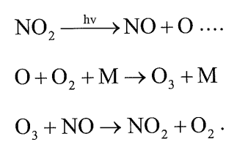
NO₂之光化學反應
NO₂具有高度之光化學反應性，波長小於0.38 µm之可見光，即可使N-O鍵斷裂，藉著反應式(7-1)中所產生之NO₂，即可引起如下一系列連鎖反應。
(7-2)
(7-3)
(7-4)
其中(7-3)式中M為中氣體之N₂或O₂，如同上述(O₃與NO反應極快)，(7-2)~(7-4)式反應均是非常快速的，其光分解循環如圖7.1所示。

Slide 62
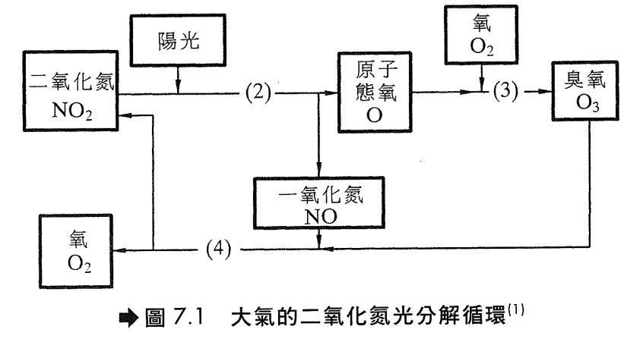

Slide 63
NO₂與O₃之關係
理論上O3之濃度為NO₂起始濃度的函數，10 ppm的NO₂，大約會有2.7 ppm之O3產生。
但事實上，NO₂濃度通常不大於10 ppm，而O₃濃度可大於2.7ppm，甚至經常可達到50 ppm。
某些相關機制使NO氧化成NO₂而不消耗O₃，使得O₃逐漸累積。

Slide 64
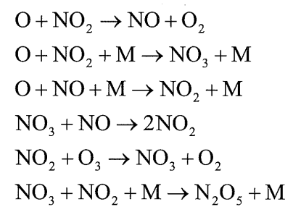


其他反應式
反應可能包括許多其他物質，如氮及氧等，反應包括下列各式:
某些物質最後會從一系列的反應中被去除，例如由大氣中蒸氣水滴的存在，我們可得
(7-5)
NO₂ 於氣相中亦會水解成
(7-6)
(7-5)、(7-6)二反應式所得之硝酸皆可進一步反應生成硝酸鹽

Slide 65
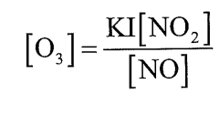
碳氫化合物於NOx光化學反應中的角色
(7-2)~(7-4)光化學反應式動力學方程式可表示為:
(7-7)
式中I 表示光線之強度
大氣反應複雜性之增加，乃是因碳氫化合物之存在而引起，由反應式(7-2)所形成之O(氧原子)小部分可與許多有機化合物反應生成自由基(Free radical)
(7-8)
而反應式(7-3)所形成之O₃亦可與碳氫化合物反應生成自由基及醛類(RCHO)
(7-9)

Slide 66
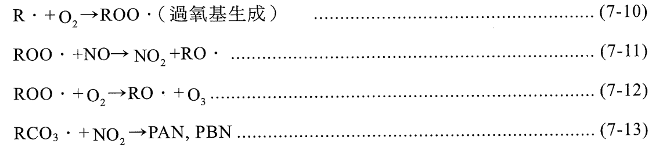
(7-9)式中所生成之醛類，本身即為一種污染物。自由基再進行下列反應:
反應式(7-11)除了增加[NO₂]濃度外，亦減少了NO於(7-4)式中與O₃反應的機會，而提供了增加O₃濃度的機制。另外透過(7-12)式，亦可使O₃之濃度增加。
NO₂則與碳氫化合物自由基RCO₃反應，生成光化學污染物過氧硝酸乙醯酯(PAN)。

Slide 67
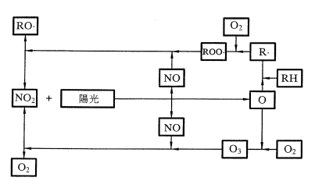
NO₂受陽光照射所生成之NO，大部份與R-O-O·自由基作用(圖7-2 上層)，因此與O₃反應者較少(下層)，亦即NO消耗O₃作用被破壞，O₃濃度因而增加，同時NO與R-O-O ·反應亦使NO₂之濃度增加。
此光化學反應模型所做之預測結果與圖7.3在時間上相符，光化學煙霧形成之反應體系請參考圖7.4。

Slide 68
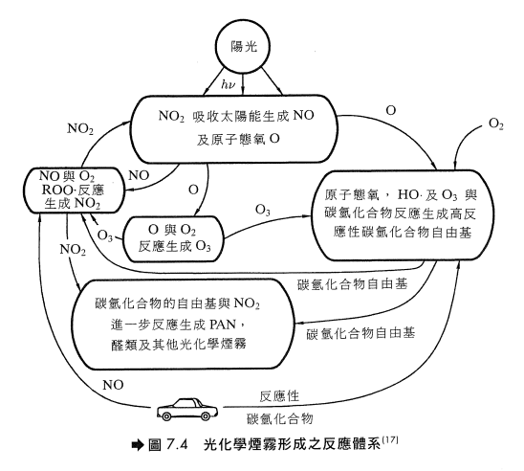
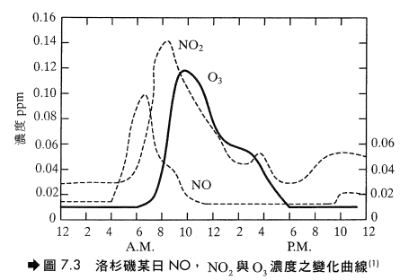

Slide 69


光化學煙霧中刺激物之形成
醛的形成
醛類對眼睛具刺激性。
過氧硝酸乙醯酯(PAN, Peroxyl Acetyl Nitrate)的形成
PAN為強烈眼睛刺激物，並能傷害植物

Slide 70

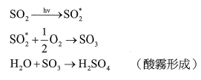
PBN (Peroxyl Benzoyl Nitrite)
其對眼睛之刺激較PAN強100倍。
酸霧形成
此外SO₂經過波長2900到4000Å可見光作用下，也可發生光化學反應而形成SO₃。

Slide 71
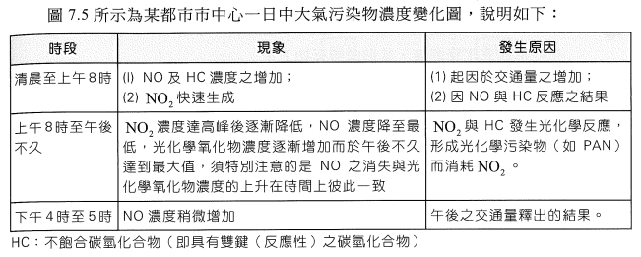
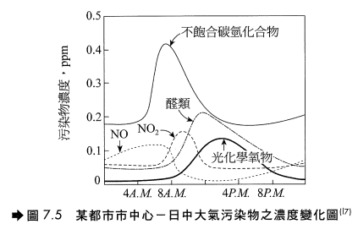
光化學煙霧之污染過程

Slide 72
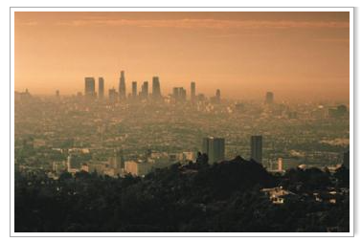
Photochemical smog
First identified in Los Angeles in 1944.
Although several other kinds of smog occur, photochemical smog (or Los Angeles-type smog) is a yellow-brown haze produced by the reaction of sunlight with exhaust from automobiles and power plants that burn coal.
Ozone, nitrogen dioxide, and other volatile organic compounds that make up this smog irritate eyes and nasal passages.
Particularly dangerous to people who have heart disease, asthma, or other respiratory illnesses, and to anyone who exercises or does manual labor outdoors when smog is heavy.

